Slide 1
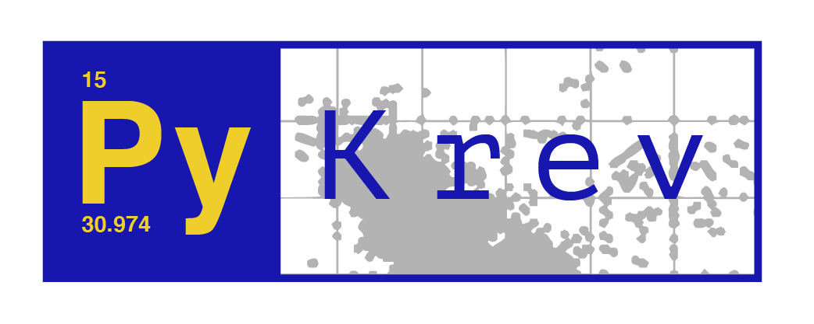
.pykrev/formula
.pykrev/diversity
.pykrev/plotting
Stoichiometric analysis
Diversity metrics
Intersection plots
Mass & compound class plots
van Krevelen
Mass analysis
Set analysis
Ordination
element_counts.py
calculate_mass.py
find_intersections.py
ordination_matrix.py
relative_intensities.py
unique_plot.py
kendrick_mass_defect_plot.py
van_krevelen_plot.py
element_ratios.py
kendrick_mass_defect.py
unique_groups.py
bray_curtis_matrix.py
diversity_indices.py
missing_plot.py
atomic_class_plot.py
double_bond_equivalent.py
missing_groups.py
compound_class.py
+ Upset plots using UpSetPlot
multi_van_krevelen_plot.py
filter_spectral_interference.py
compound_class_plot.py
aromaticity_index.py
van_krevelen_histogram.py
nominal_oxidation_state.py
mass_histogram.py
read_formularity.py
mass_spectrum.py

